Slide 1

Bridging the Gap
A new approach to visualizing and modeling the United States’ aging critical infrastructure.
Evan Jones

Slide 2
Problem Overview:
“There are more than 617,000 bridges across the United States. Currently, 42% of all bridges are at least 50 years old, and 46,154, or 7.5% of the nation’s bridges, are considered structurally deficient, meaning they are in “poor” condition.“
– American Society of Civil Engineers 2021

Slide 3

Present Offerings/Solutions:
Visualization Offerings
Modeling Offerings
Bridge Selection & Data Table Presentation
Bridge Geographic Mapping
“Base Models” with Grouping & Subset Statistics
“Machine Learning Models” CNN’s
Bridge Performance History & Forecast Plots
“Survival Models” Markov Chain Models

Slide 4
How can we add value?
Visualization Improvements
Modeling Improvements
Modeling Improvements
Improve the visualization quality, usability, & ascetics
Create dynamic visualizations that respond to changes in underlying model assumptions
Include bridge images to better connect users with their locality
Filter, streamline, and consolidate data offerings
Offer visualization of currently active projects
Offer locality comparison tool
Offer ranking visualization tool
Experiment with alternative modeling approach
Leverage additional data-sources to augment model
Model impact of bridge closure on surrounding alternate routes
Model estimated repair time and completion of planned or ongoing repairs
Offer several modeling approaches for users to experiment with
Offer scenario analysis modeling of best- and worst-case outcomes

Slide 5



Data Collection & Integration
Traffic Load/Accident Data
Custom file format still working on how to effectively parse but is doable. Initial size very large, but only needs to be processed once through offline
RT/Historical Weather & Climate Data
Utilize API offerings to retrieve necessary data on demand. Data size flexible depending on later determined need for granularity
Bridge Collapse & Causes Dataset
1000 Rows ~20 Columns; relatively small csv download; Includes all major data for US bridge collapses
Individual Bridge Location & Status
Primary Data Source; 600K Rows with 30+ Columns; Most information can be reduced in column side; Flexible direct download options by State.

Slide 6
Data Cleaning
Largest problem will be alignment and consolidation of the four primary datasets
Possible scale errors in traffic and accident data, but can be identified with low level outlier analysis and removal
Duplication/renaming of bridges happens from time to time and may not always be represented in InfoBridge data.

Slide 7
Data Analysis
Create new and/or expand existing bridge failure & rating models
Apply scenario analysis to effectively identify range of future outcomes under different underlying assumptions (weather, traffic, etc.)
Create modeling framework for project cost estimation or completion time forecasting

Slide 8
Visualization
Interactive map of the United states at State level; Choropleth representing state of average bridge rating
Allow user to select a state, choropleth will zoom on selection and display point makers for each bridge in the state
Users hover over a point marker and will see a small image of the corresponding bridge with a summary of condition etc.
Users will have the option to show additional data on specific selection which will open a side pane with full bridge data, forecasts, and other relevant visualizations

Slide 9
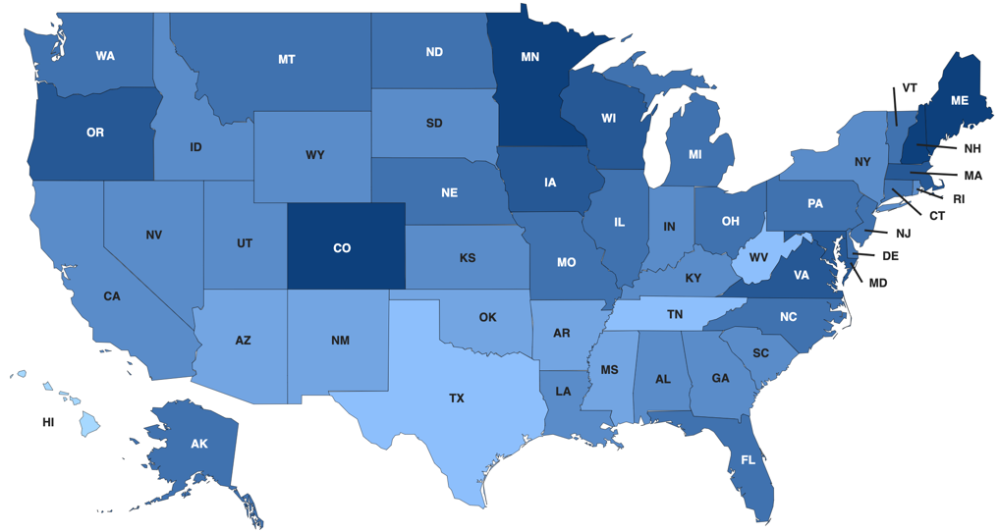
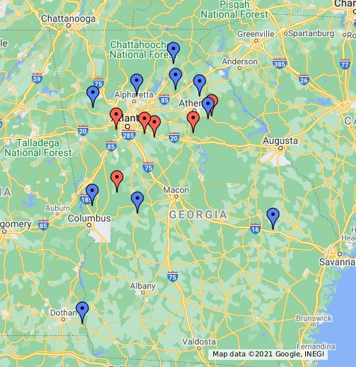
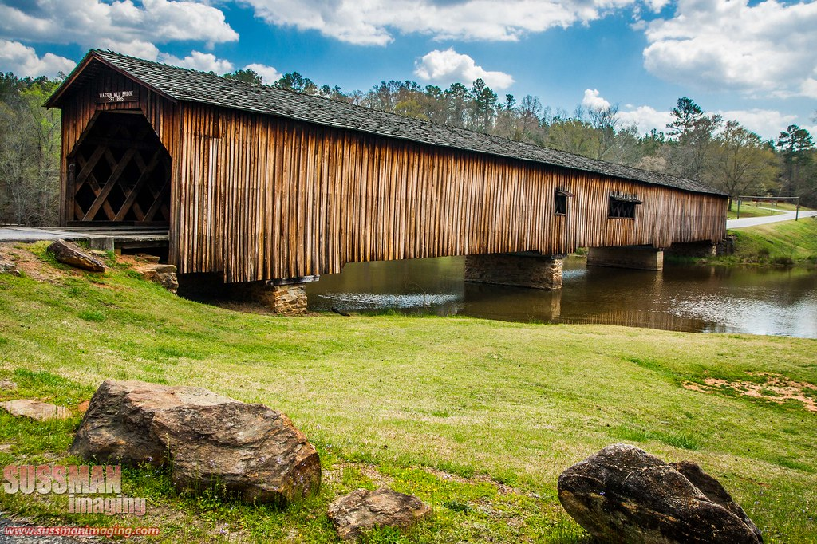

Watson Mill Bridge
Arnoldsville, GA
Expand Selection…

Slide 10
Presentation & Dissemination
Present the content in the form of an interactive standalone webpage
Utilize d3, CSS/SCSS, & JavaScript for frontend
Several options for backend and data management depending on group preference
Host and publish site using git-hub pages
Make trained models available via GitHub as well

